Slide 1
Pulmonary Embolism:
Stop the Block
Ronael Schneeberger, RN, BSN
MSN Student Spring 2012
MSN621 – Alverno College
Ronael.Schneeberger@alverno.edu

Slide 2
Objectives of Tutorial
Define pulmonary embolism (PE).
Identify what makes PE different than deep vein thrombosis (DVT).
Detect risk factors that contribute to PE.
Identify common signs and symptoms of PE.
Isolate routine tests ordered to diagnose PE.
Recognize standard treatments for PE.

Slide 3
Patient Scenario
44 year old, female.
Presents with complaints of a non-productive cough, episodes of difficulty breathing the last couple of days, and a feeling of her chest burning with cough.
Where do you think this information will take you?
Emergency Department (ED)
Microsoft Clip Art

Slide 4
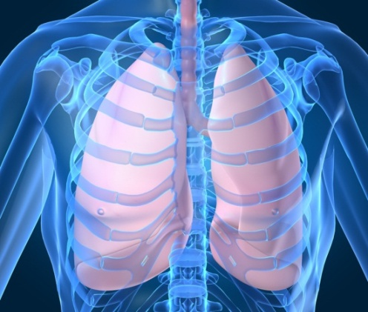
What is Pulmonary Embolism?
Pulmonary Embolism (PE) occurs when a blood-borne substance (most often a DVT) lodges in a branch of the pulmonary artery and obstructs flow.
Bits of plaques, fat, and air bubbles may also be called emboli, thus causing a pulmonary embolism. For example, if plaques involved in atherosclerosis break free and move through the blood stream, they may lodge in the branch of the pulmonary artery and cause a PE.
This tutorial focuses on PE due to thrombus only.
Porth & Matfin 2009
Microsoft Clip Art

Slide 5
Pathway from DVT to PE
Almost all pulmonary emboli are thrombi that are a result of deep vein thrombosis (DVT) of the lower extremities.
Thus, most likely the clot started in the femoral, popliteal, or iliac vein. From there, it traveled through the inferior vena cava, then to the right atrium of the heart and onto the right ventricle of the heart. Finally, it stops somewhere in a branch of the pulmonary artery.
Thompson & Hales 2011

Slide 6
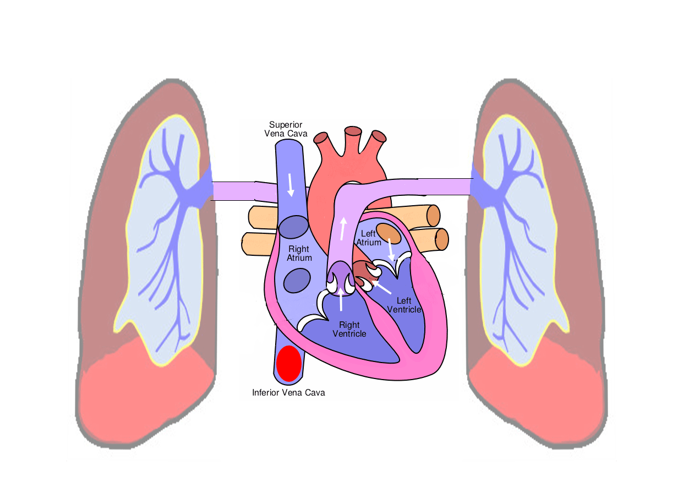
Example Pathway of DVT to PE
Adapted from Wikimedia and Clker.com

Slide 7
Our Patient in the ED Now Tells Us:
She has a history of hip surgery 2 months previously.
She smokes a ½ pack of cigarettes per day.
After her last child was born she developed a DVT in her lower leg.
Her daily medication includes an oral contraceptive pill (she is unsure of name).
She was seen twice over the last 6 weeks for cough and completed Zithromax and Levaquin but this cough is just getting worse and now her chest bothers her.
Microsoft Clip Art

Slide 8
What Are the Risk Factors for PE?
Venous stasis and venous endothelial injury
  Prolonged bed rest
  Trauma
  Surgery
  Childbirth
Hypercoagulability states
  Thrombophilias (antithrombin deficiency, protein C and S deficiencies, and factor V Leiden mutation).
  Cancer
  Use or oral contraceptives (increased with smoking)
  Pregnancy
  Previous history of DVT and/or PE or concurrent diagnosis of DVT.
  Fracture of hip & femur
  Myocardial infarction (MI)
  Congested heart failure
  Spinal cord injury
Microsoft Clip Art
Porth & Matfin 2009

Slide 9
Let’s Evaluate
Our patient that presented to the ED had many risk factors for PE formation. Can you name them?
Recent surgery, history of DVT, and recent course of antibiotics.
Try again! Recent surgery and previous DVT do increase the risk of PE formation. However, recent antibiotic use is not a risk factor for PE.
Recent surgery, history of DVT, smoker, and taking an oral contraceptive pill
Right! Recent surgery leads to venous stasis or endothelial damage. Smoking and contraceptive pill increase risk by increasing resistance to anticoagulants.

Slide 10
And Now Our Patient in the ED Adds:
She has had shortness of breath with activity for the last 6 weeks.
You have now checked her vitals: Blood Pressure is 90/45, Temperature is 98.8, Pulse is 130, Respiratory rate 24, and pulse ox 92%.
And remember today she presents with complaints of a non-productive cough, episodes of difficulty breathing the last couple of days, and a feeling of her chest burning with cough.

Slide 11
Signs and Symptoms of PE
Embolism in the lung will cut off blood flow beyond the point where it is lodged. This stops the normal exchange of oxygen and carbon dioxide in the affected artery. The heart is now also pumping against a blocked vessel. What signs and symptoms might a patient present with if they have a PE?
Chest Pain
Right! A blood clot becomes lodged in the pulmonary artery, blocking blood flow to lung tissue causing chest discomfort.
Cough
Right! Bronchoconstriction in the lung due to impaired pulmonary blood flow may cause this.
Normal Breathing
Try again. Let us think about this. If air exchange is impaired due a blockage you may have shortness of breath (dyspnea).
Hypertension
Oops! The patient may have hypotension not hypertension. The clot blocks the outflow of blood from the right side of the heart to the lungs leading to hypotension.
Decreased Pulse
Try again. Pulse increases. Not enough O2 is being delivered and your heart is working harder pumping against a blocked vessel.
Low Oxygen Saturation
Right! Due to impaired gas exchange. Remember normal exchange of oxygen and carbon dioxide is stopped due to the embolism.

Slide 12

Do Patients Always Have Signs/Symptoms of PE?
The situation used in this tutorial is an ideal situation.
Pulmonary embolism is frequently asymptomatic (Thompson & Hales 2011).
Approximately one third of patients with deep venous thrombosis have silent pulmonary embolism (Stein, et al 2010).
Microsoft Clip Art

Slide 13
Common Tests Used in Diagnosis
D-dimer – If this test is negative not likely a PE. If positive you must evaluate further for PE, but it may be elevated due to many other reasons.
Chest X-ray – May show cardiomegaly, which is the most common chest radiographic abnormality associated with acute pulmonary embolism (Elliott et al. 2000).
Chest CT – Will show the blockage by the emboli. This is main tool used in diagnosing. Click here to see CT example (Thompson & Hales 2011).

Slide 14
Other Tests You May See
EKG – May show signs of right side heart strain or sinus tachycardia. This is mainly used to rule out myocardial infarction and is not a specific test (Thompson & Hales 2011). Click here to see EKG example.
Pulmonary Angiography – “gold standard” However, not used often in practice due to being so invasive (Porth &Matfin 2009).
Blood Gas - may show reduced PaO₂, reduced PaCO₂ due to hyperventilation, or acidosis. Studies are showing this may not be a reliable method to diagnose PE and today may not be ordered routinely (Rodger et al. 2000).

Slide 15
Our Patient Has Some Tests Completed:
The following tests are ordered to begin: electrocardiogram (EKG), chest x-ray, D-dimer.
Microsoft Clip Art

Slide 16

Our Patient’s Tests Reveal…..
What do you think the patient’s initial tests would reveal if she has a PE?
D-dimer Normal
Try again! It was elevated! D-dimer is a small protein fragment present in the blood after a blood clot is degraded by fibrinolysis. This can be measured with a blood test. If positive you must continue to evaluate for PE. If negative you can almost always rule out PE.
Chest X-ray Abnormal
Correct! It revealed cardiomegaly. Enlarged 50% compared to x-ray from 3 weeks ago.
EKG Shows Sinus Tachycardia
Right! Sinus tachycardia may be an indicator of PE.
Microsoft Clip Art

Slide 17
So What Would You Order Next?
The patient now has an elevated D-dimer, abnormal chest x-ray, and EKG changes what test would you order next?
Pulmonary Angiography
Try Again! This is a great guess but in practice, since this test is so invasive it is rarely used to diagnose PE. It is however, the “gold standard.”
Chest CT
Correct! It is the least invasive way and most accurate way to identify the blockage by the emboli.

Slide 18
The Result Is In…….
The patient’s CT revealed a large saddle embolus. Click here to see a picture of a saddle embolus.
Now we need to treat this patient. Let’s explore our options.
Microsoft Clip Art

Slide 19
Treatment
In patients with large or multiple emboli and associated hemodynamic instability, thrombolytic drug therapy may be used (Porth & Matfin 2009).
Heparin, intravenously (IV) or low molecular weight heparin (LMWH), subcutaneously, follows thrombolytic therapy or is the main treatment for smaller, single emboli. LMWH has been shown to be safer and as effective as heparin (Ramzi & Leeper 2004).
Warfarin, orally, is initiated to prevent the reoccurrence of clots.

Slide 20
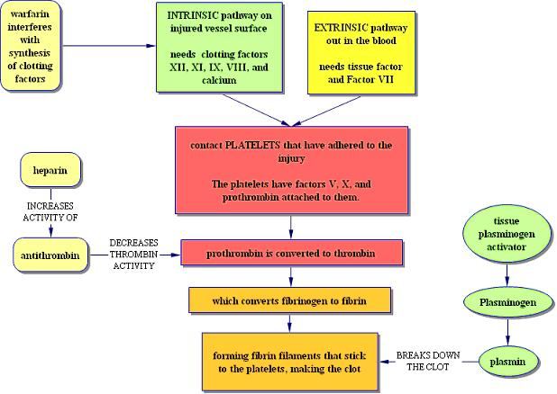
Let’s Remember How These Medications Work!
(Bowne 2004-2010)

Slide 21
Thrombolytic Drug Therapy
Thrombolytic drugs include Urokinase, Streptokinase, and recombinant Tissue Plasminogen Activator (rTPA).
Dosing is based on the patient weight and administered intravenously (IV).
This drug is used cautiously due to significant side effects including hemorrhage.
There is not set criteria for when the use of these medications should be used to treat PE.
(Almoosa 2002)

Slide 22
Thrombolytic Therapy Continued….
During administration of thrombolytics, laboratory monitoring is unnecessary. After the infusion is given, PTT should be measured. If it is less than 2.5 times the control value, a heparin infusion should be started and adjusted to maintain a PTT of 1.5 to 2.5 times the control. If the PTT initially is greater than 2.5 times the control it should be checked every four hours, and heparin should be started if the PTT drops below this level.
(Almoosa 2002)

Slide 23
Information on Heparin
Standard treatment of PE requires a continuous IV infusion of heparin with the dose adjusted to a target a PTT of 60 to 80 seconds. IV heparin is administered throughout the hospitalization, which typically averages 5 to 7 days, until the warfarin has become fully effective (Goldhaber & Grasso-Correnti 2002).
More providers are using low molecular weight heparin (LMWH) injections, called Lovenox or Innohep, rather than IV heparin. LMWH has been shown to have advantages and be just as effective as heparin (Ramzi & Leeper 2004).
)

Slide 24
Information on Warfarin
Warfarin (coumadin) cannot be prescribed in a fixed or weight-adjusted dose. Instead, the dose must be adjusted according to a laboratory blood test that measures the length of time it takes for clotting to begin, or prothrombin time (PT).
The test is standardized to account for different laboratory processes and is called the International Normalized Ratio (INR).
The INR of a healthy individual not taking warfarin is 1.0. The INR increases with increasing intensity of anticoagulation.
For patients with DVT or PE, the usual target INR is 2.0 to 3.0. The target INR may be raised to levels as high as 4.0 for intensive coagulation.
(Goldhaber & Grasso-Correnti 2002)

Slide 25
Let’s Check Your Knowledge
What medication do you expect to see ordered immediately for our emergency department patient with a saddle emboli and low blood pressure?
Warfarin
Good try! Warfarin prevents further clot formation by interfering with the synthesis of clotting factors.
Heparin
Try again. Heparin prevents further clot formation by increasing the function of antithrombin. It is used for small or single emboli.
rTPA
Correct! rTPA works to break down the current clot by activating plasminogen which forms plasmin to break down the clot. It is it used in large lots like a saddle embolism and when there hemodynamic instability (hypotension).

Slide 26
Summary
Pulmonary embolism is a common and sometimes fatal condition.
Prompt diagnosis and treatment can reduce mortality.
Remember, this tutorial demonstrated the ideal clinical situation.
Microsoft Clip Art

Slide 27
Literature Cited
Almoosa, K. (2002). Is thrombolytic therapy effective for pulmonary embolism? American Family Physician, 65(6), 1097-1103.
Goldhaber, S. & Grasso-Correnti, N. (2002). Treatment of blood clots. Circulation. 106, 138- 140.
Porth, C.M. & Matfin, G. (2009). Pathophysiology: Concepts of altered health. Philadelphia, PA: Lippincott, Williams & Wilkins.
Ramzi, D. & Leeper, K. (2004). DVT and pulmonary embolism: Part II. Treatment and prevention. American Family Physician, 69(12), 2841-2848.
Rodger, M., Carrier, M., Jones, G., Rasuli, P., Raymond, F., Djunaedi, H., & Wells, P. (2000). Diagnostic value of arterial blood gas measurement in suspected pulmonary embolism. American Journal of Respiratory and Critical Care Medicine, 162(6), 2105-2108.
Stein, P., Matta, F., Musani, M., & Diaczok, B. (2010). Silent pulmonary embolism in patients with deep venous thrombosis: A systematic review. American Journal of Medicine, 123(5), 426-431.
Thompson, B.T. & Hales, C. (2011, December 23). Overview of acute pulmonary embolism. Retrieved February 11, 2012 from UpToDate online textbook: http://www.uptodate.com.

Slide 28
Images Cited
Bowne, Pat. Hemostasis. Retrieved February 17, 2012 with permission from Bowne, P.S., 2004-2010, PATHO Interactive Physiology Tutorials: http://faculty.alverno.edu/bowneps/hemostasis/h19.htm
Clker.com. (n.d.) Retrieved March 4, 2012: http://www.clker.com/clipart28685.html
EKGinterpretation.com. (n.d.) Retrieved February 17, 2012 with permission. http://www.ekginterpretation.com/library/acute-pulmonary-embolism/
Wiki. (n.d.) Retrieved March 14, 2012: http://en.wikipedia.org/wiki/File:SaddlePE.PNG
Wiki. (n.d.) Retrieved March 1, 2012: http://en.wikipedia.org/wiki/File:Saddle%20thromboembolus.jpg
Wiki. (n.d) Retrieved March 4, 2012: http://commons.wikimedia.org/wiki/File:Diagram_of_the_human_heart_(cropped).svg

